Slide 1
Introductory course for first year students

Slide 2
Palacký University Information System PORTAL www.portal.upol.cz
Access your study records
Check your schedule
Register for examinations
Register for a study group
Register for elective and optional subjects

Slide 3
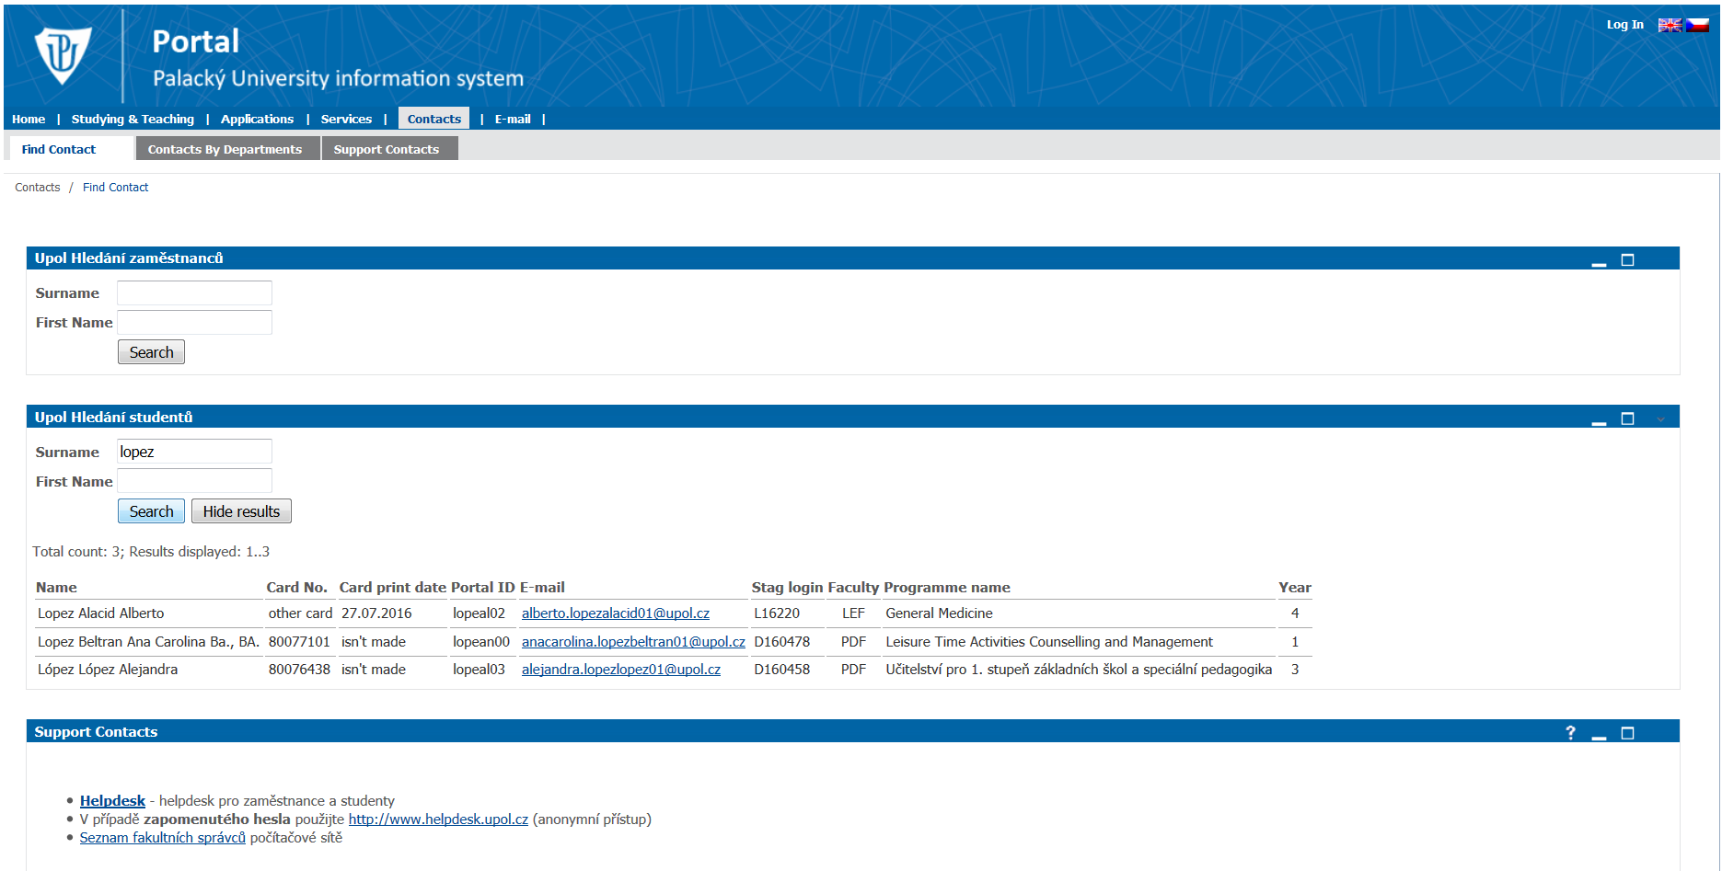
Palacký University Information System PORTAL
To access PORTAL, you need your login

Slide 4
Palacký University Information System PORTAL
To access PORTAL, you need your password
So called „Birth Certificate Number“ assigned for registration
Found in your credit book, below your photograph

Slide 5
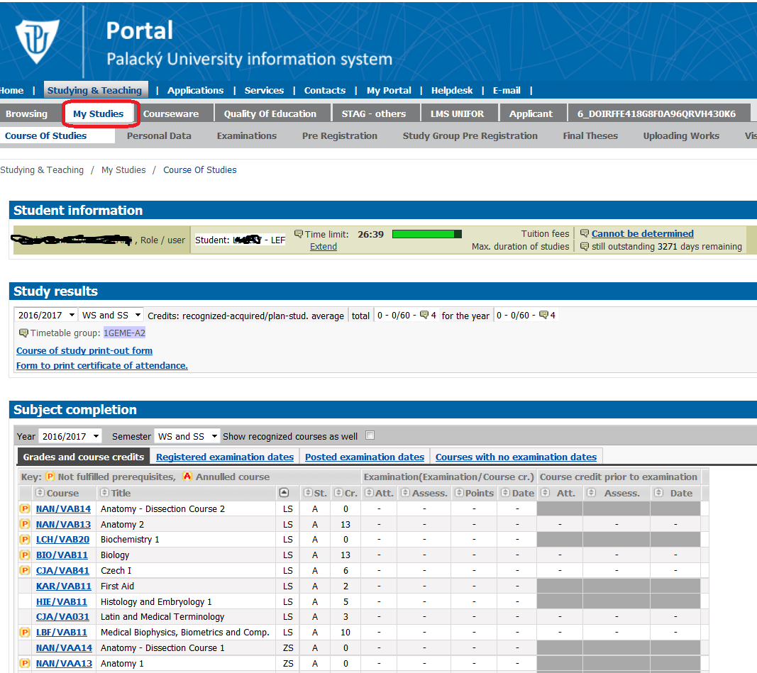
Palacký University Information System PORTAL
See all your courses and their results

Slide 6
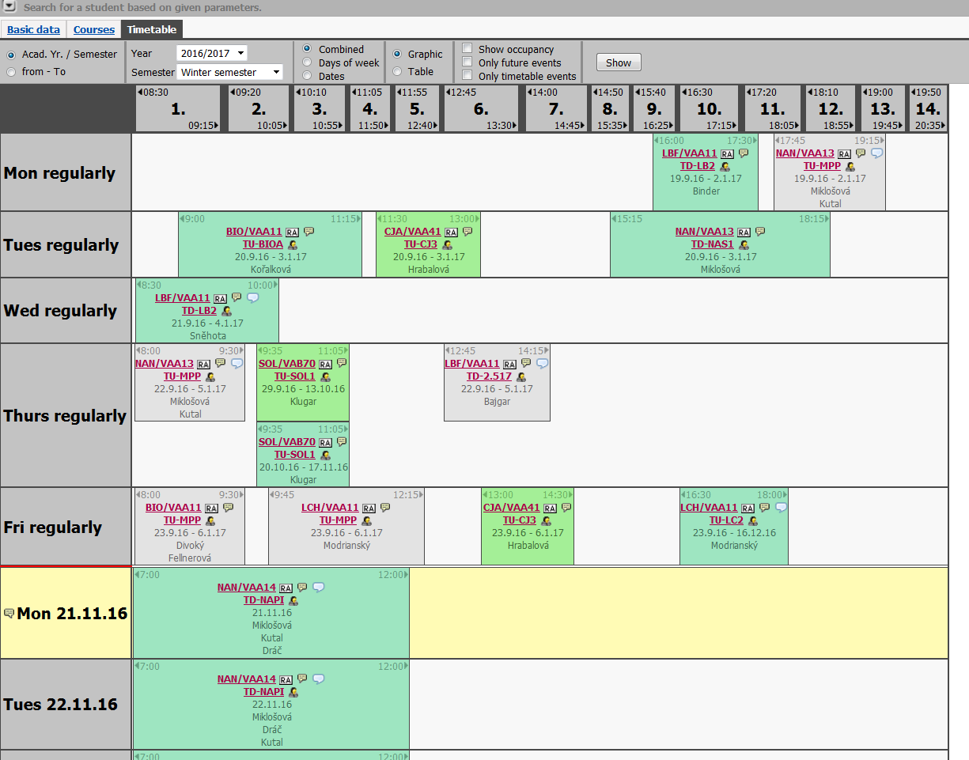
Palacký University Information System PORTAL
See your schedule

Slide 7
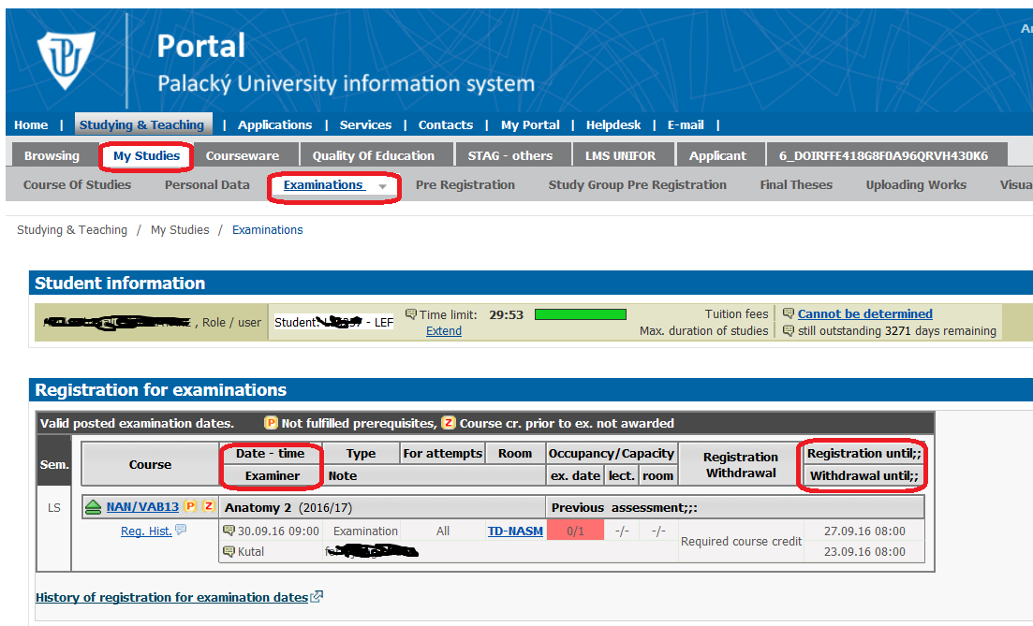
Palacký University Information System PORTAL
Register for exams

Slide 8
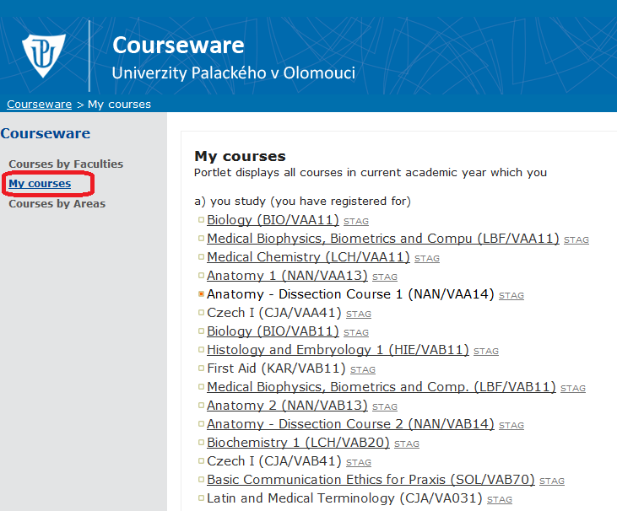
CourseWare www.courseware.upol.cz
Information about individual subjects
Course requirements, lectures, study materials…..

Slide 9
The course of studies
FIRST YEAR
Must be registered for all obligatory subjects
Must complete ALL obligatory subjects by the end of your first year.
Failure to comply = reason for termination of studies

Slide 10
The course of studies
Winter Semester examination period
in the academic year 2016/2017
January 09 to February 10

Slide 11
The course of studies
Summer semester examination period
in the academic year 2016/2017
May 29 to June 30

Slide 12
The course of studies
ALL SUBJECTS
from this academic year 2016/2017
MUST BE completed by
September 04, 2017

Slide 13
The course of studies
Attendance of practical classes is OBLIGATORY!!!
Maximum one third of classes can be missed if properly excused from.
Relevance of your excuse considered by the responsible teacher.
If your excuse not accepted, you have the right to ask a head of the respective department to review your case.
Missed classes HAVE TO BE SUBSTITUTED!

Slide 14
The course of studies
CREDIT SYSTEM
credits acquired for completion of subjects
OBLIGATORY SUBJECTS – 60 credits in your first year
ELECTIVE SUBJECTS – General Medicine - 7 credits throughout your studies – Dentistry - 1 credit throughout your studies
OPTIONAL SUBJECTS – 5 credits throughout your studies (General Medicine only)

Slide 15
The course of studies
A subject can be registered twice = carried forward to a higher year (not in the first year!)
System of prerequisites – may prevent you from registering certain subjects (from 2nd year onwards) = some subjects can only be registered upon registration ("soft prerequisite ") or completion (" hard prerequisites ") of other subjects
Must acquire a minimum of 80 credits over two years!

Slide 16
Registration for Examination Dates
For all examination dates, register through Portal.
Withdrawal from an examination date you registered for not later than seven days before an examination date.

Slide 17
Examinations and Retakes
Registration for an exam only once you have acquired „credit“
In the event of no-show without a reasons of a serious nature given to the examiner within two days of the examination date
your examination is considered as
FAILED

Slide 18
Examinations and Retakes
You have THREE attempts to pass an exam
If you fail for the first time: first retake
If you fail for the second time: second retake always a board examination, board appointed by the head of the responsible department.

Slide 19
Examinations and Retakes
Keep it formal!
Smart dress code is recommended when appearing for an examination

Slide 20
Recognition of subjects
Reviewed by respective departments
Submit
Application for recognition
Original transcript of records
Contents of a respective subject
Only subjects completed less than three years ago can be recognised
DEADLINE: September 23

Slide 21
Study and Examination Code of Palacký University
The Study and Examination Code
used at Palacký University Olomouc is available in the “White Book” (school catalogue) at the following webpage
http://www.lf.upol.cz/en/groups/studying/master-degree-programmes/general-medicine/school-catalogue-white-book/

Slide 22
Matriculation ceremony
Wednesday
September 21
Big Lecture Hall
starts at 9:30 am
Meet us at 9:00 am in the Right lecture hall

Slide 23
FB group: Faculty of Medicine and Dentistry UP
/

Slide 24
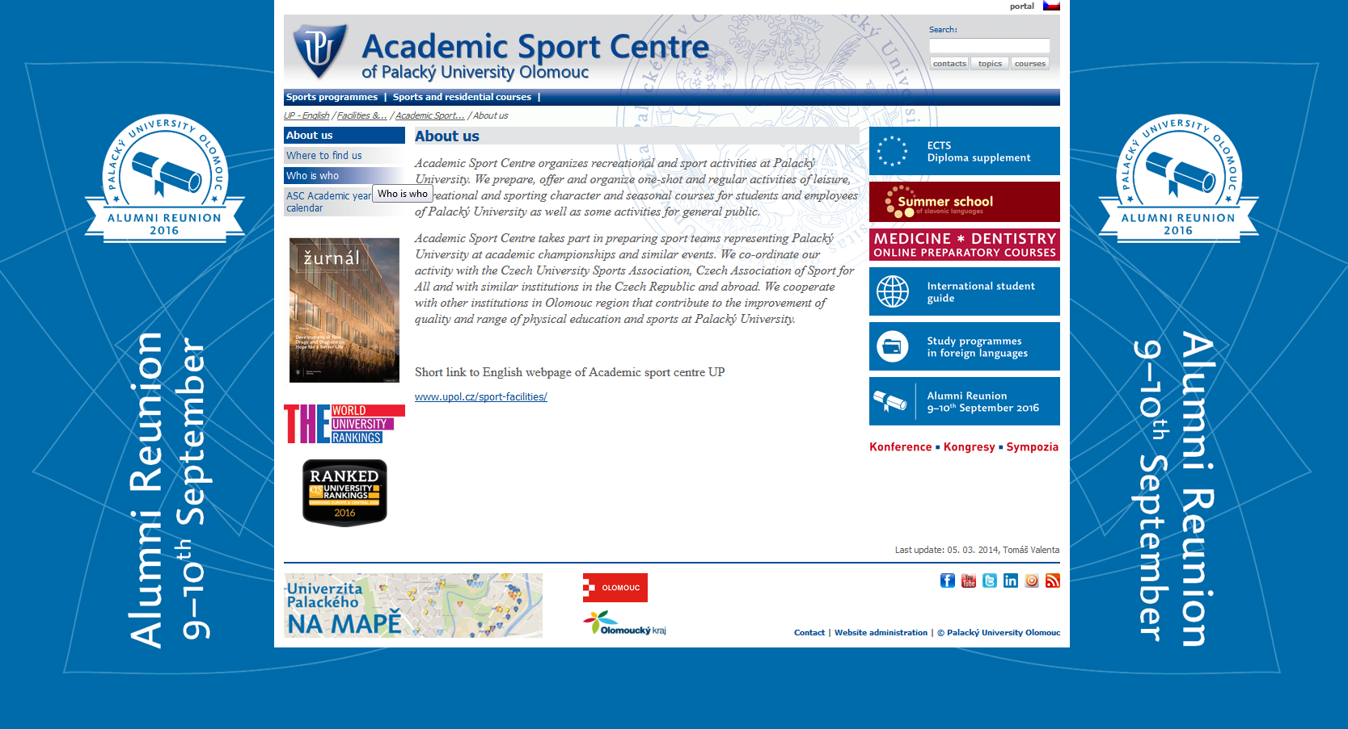
Academic Sport Centre

Slide 25
Effective communication
Try to find the information you need on the website first
Use your faculty email address
Keep it brief
Do not forget to sign your email with your full name!

Slide 26
Health Check
Will be scheduled within the next few weeks
Blood tests
Chest X-ray
Hep B vaccination

Slide 27
Change in personal data
Change of
Address
E-mail address
Phone numbers
INFORM THE REGISTRARS

Slide 28
THANK YOU
for
YOUR ATTENTION

